Slide 1
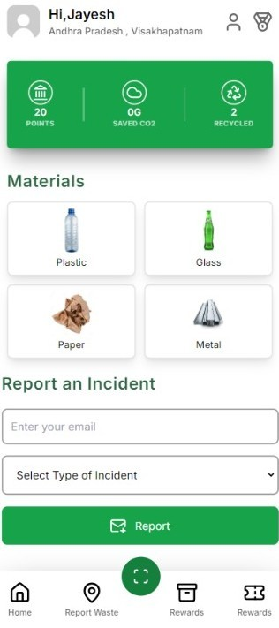
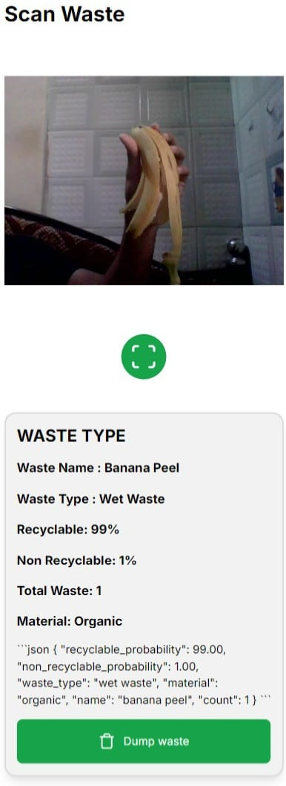
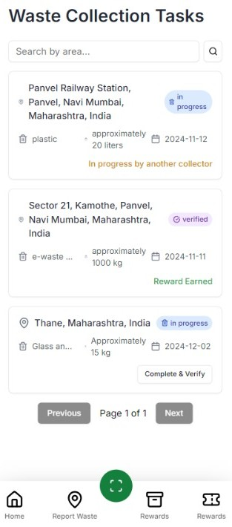
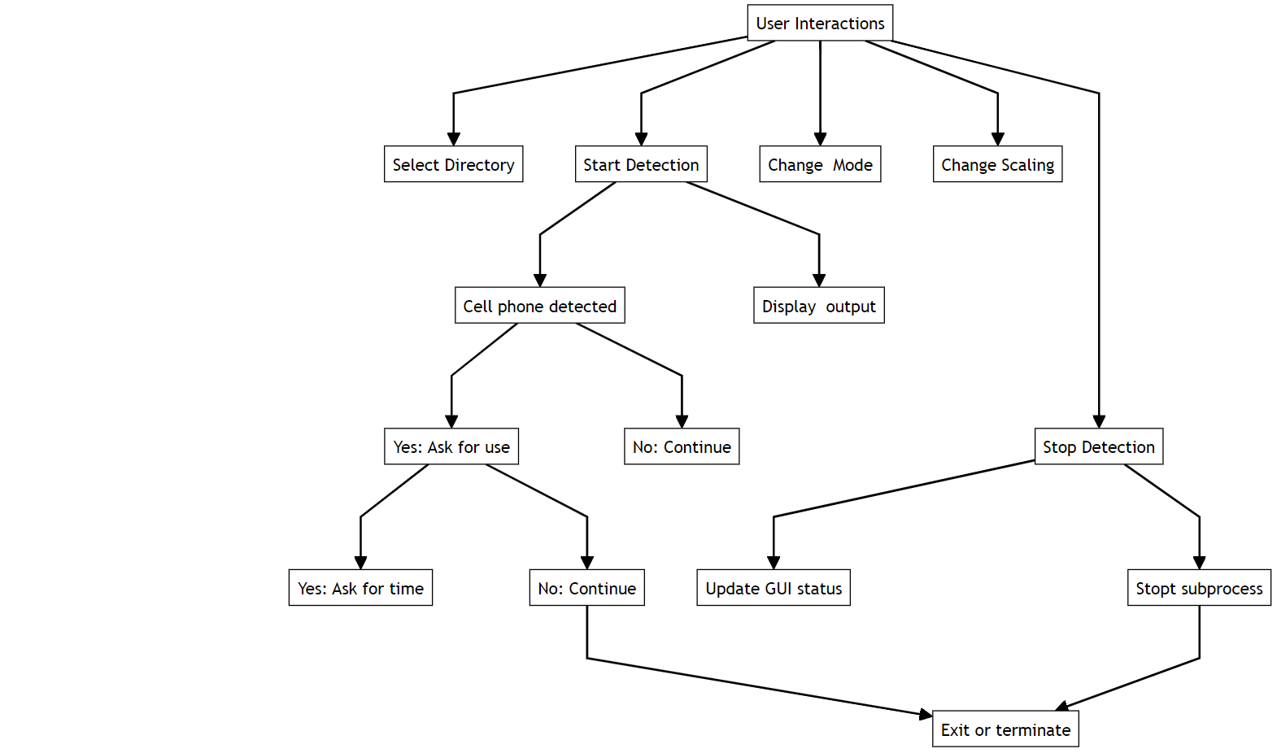
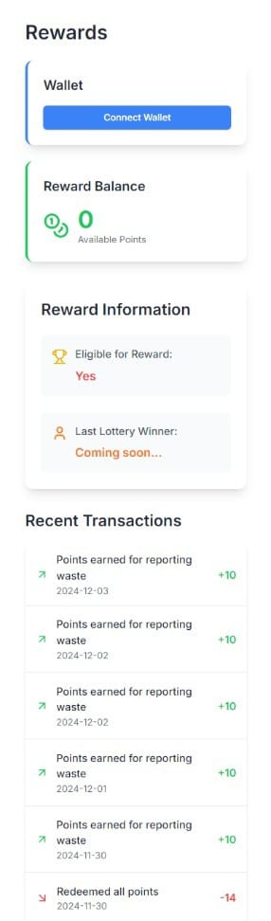
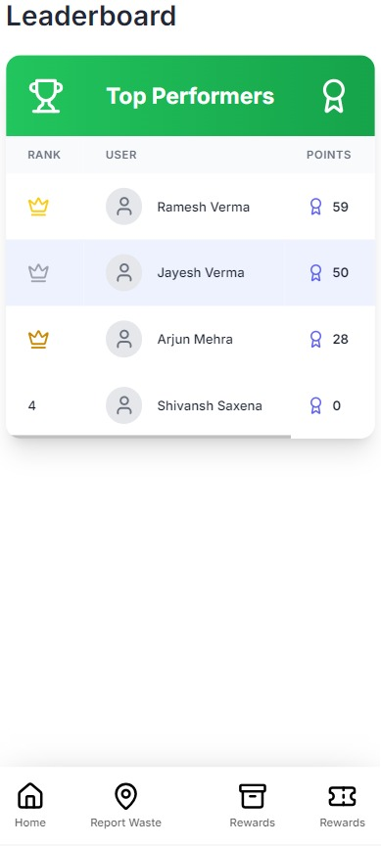
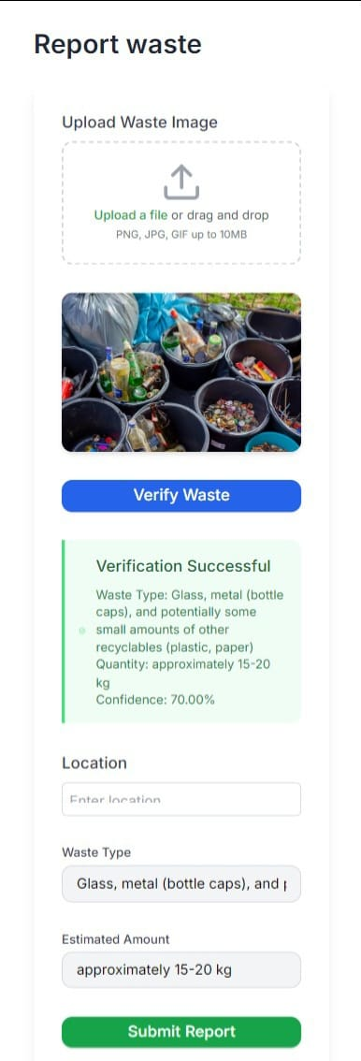
WasteEasy:Rewarding Environmental Action
CATEGORY: 05
Slot no.:
LEVEL: UG
Introduction
Objective
Methodology
WasteEasy is a platform that rewards individuals for eco-friendly actions, promoting sustainable waste management. By using AI and gamification, it encourages users to report waste, participate in clean-ups, and adopt green habits. WasteEasy turns environmental care into a rewarding experience, helping build cleaner communities and a greener world.
WasteEasy aims to incentivize eco-friendly behaviors by rewarding users for actions like waste reporting, clean-up participation, and sustainable practices.
AI Waste Identification: Use AI to detect and classify waste.
Reward System: Users earn points for eco-friendly actions.
Community Engagement: Promote clean-up events and eco-challenges.
Progress Tracking: Track and display users' environmental impact.
Screenshots
Expected outcome
Increased Engagement: Higher participation in waste management and eco-friendly actions.
Environmental Impact: Reduced waste and cleaner communities through collective efforts.
Reward System Success: User motivated by rewards , turning sustainability into a habit.
Community AwarenessEnhance environmental awareness and a stronger sense of responsibility.
Program Flow
Key Features
AI Waste Identification: Detects and classifies different types of waste.
Progress Tracking:Monitor individual contributions to environmental improvement.
Eco-Marketplace:Redeem points for sustainable products and services
Social Sharing: Share Achievements to inspire.
Implementation
Technology Integration:Use Gemini API for efficient waste segregation.
User Interface Design:Create an intuitive interface for waste reporting and actions.
Reward System:Utilize blockchain for secure reward tracking.
Scalability:Ensure seamless growth with a scalable platform.
Future Enhancement
Proximity Sensors: Detect nearby waste for instant action.
Wearable Integration: Connect with wearable devices for real-time notifications.
Mobile Synchronization: Link with mobile apps for seamless tracking and waste reporting.
Advanced AI: Improve waste classification and detection accuracy.
Reference
Liu, X., & Zhang, X. (2022). AI in waste management. Int. J. of Environmental Science and Technology, 19(5), 2023–2037. DOI
Tapscott, D., & Tapscott, A. (2016). Blockchain Revolution. Penguin.
Gemini API for Waste Segregation: Gemini API Documentation
Sustainable Waste Management Systems: Bjorndal, E., & Wagner, S. (2021). Overview of sustainable waste management. J. of Cleaner Production, 275, 122820. DOI
Scalable Web Platforms: Smashing Magazine (2018). Building Scalable Web Applications.
Conclusion
WasteEasy makes waste management rewarding and engaging, promoting sustainability, cleaner communities, and collective responsibility, paving the way for a greener future.

